Slide 1
May 28, 2020
GitHub and Azure
Esteban Garcia
esteban.garcia@newsignature.com
@EstebanFGarcia
SVP Azure & DevOps, New Signature
Microsoft DevOps MVP
Microsoft Regional Director

Slide 2




Esteban Garcia
SVP of Azure & DevOps @ New Signature
esteban.garcia@newsignature.com
@EstebanFGarcia
/in/estebangarcia

Slide 3
You’ve built a web app
It works on your machine
You want to get it to Azure
Is your only optRight-click publish
@EstebanFGarcia

Slide 4
Demo
@EstebanFGarcia

Slide 5
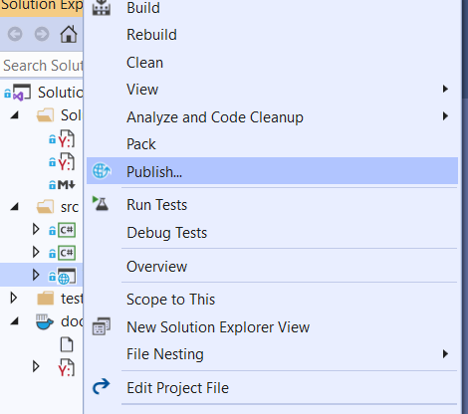

Slide 6
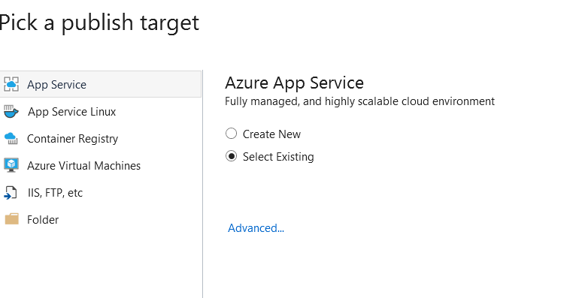

Slide 7
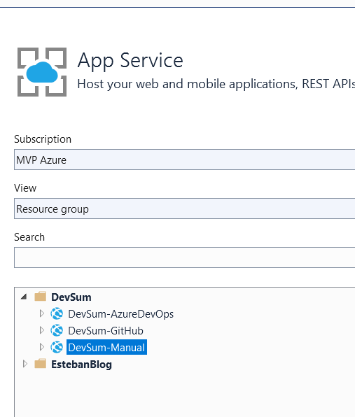

Slide 8
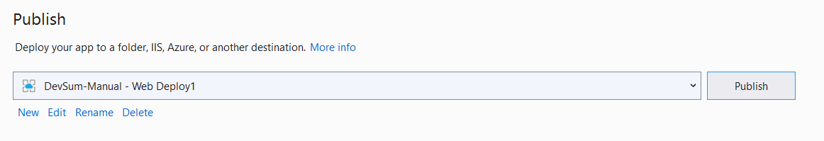

Slide 9

@EstebanFGarcia

Slide 10
And it works…but
It only deploys from your machine
What if your laptop explodes?
Or something breaks in the middle of the night?
Or you have a team?
You don’t want to have a manual process?
@EstebanFGarcia

Slide 11
Going from your laptop to Azure
Use Version control – We will use GitHub
Setup continuous integration
Lots of choices
We will cover Azure Pipelines & GitHub Actions
Deploy early and often
@EstebanFGarcia

Slide 12
















GitHub
Build
Test
Home for all developers
Home for the world’s code
Code
Release
Deploy anywhere, including your own data centers
Elastic, to any scale
Fully managed
Packages always the latest
Supports all OS for CI/CD
Largest ecosystem
Community-led automation
Plan
Deploy
Monitor
Operate
@EstebanFGarcia

Slide 13
Demo
github.com/estebang/eShopOnWeb
@EstebanFGarcia

Slide 14
Azure Pipelines
Any language/any platform
Containers & Kubernetes
Extensible
Deploy to any cloud
Free for Open Source
Advanced Workflows and features
@EstebanFGarcia

Slide 15
Demo
dev.azure.com/esteban-demo/DevSum
@EstebanFGarcia

Slide 16
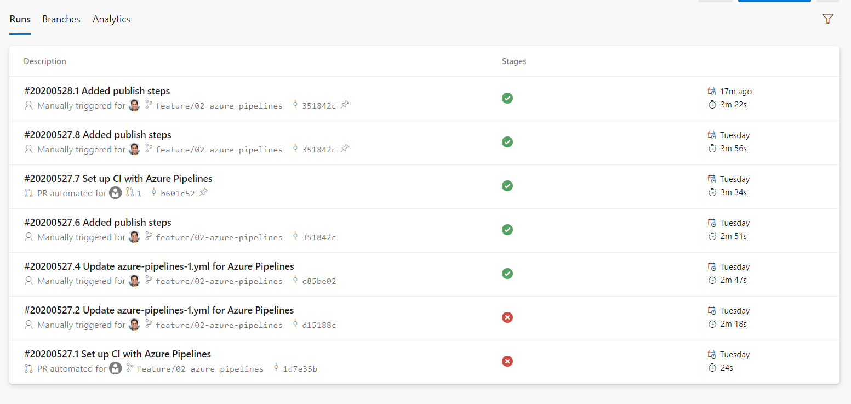

Slide 17
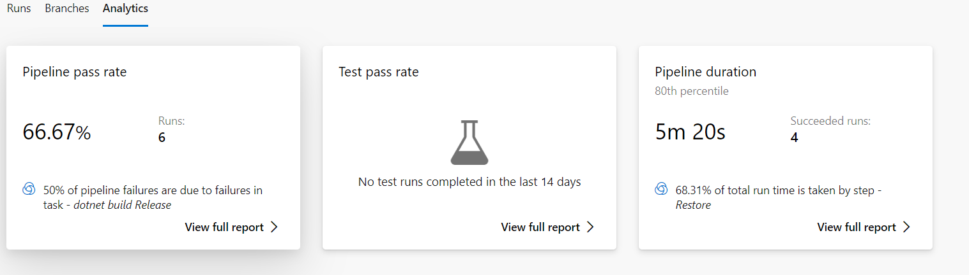

Slide 18
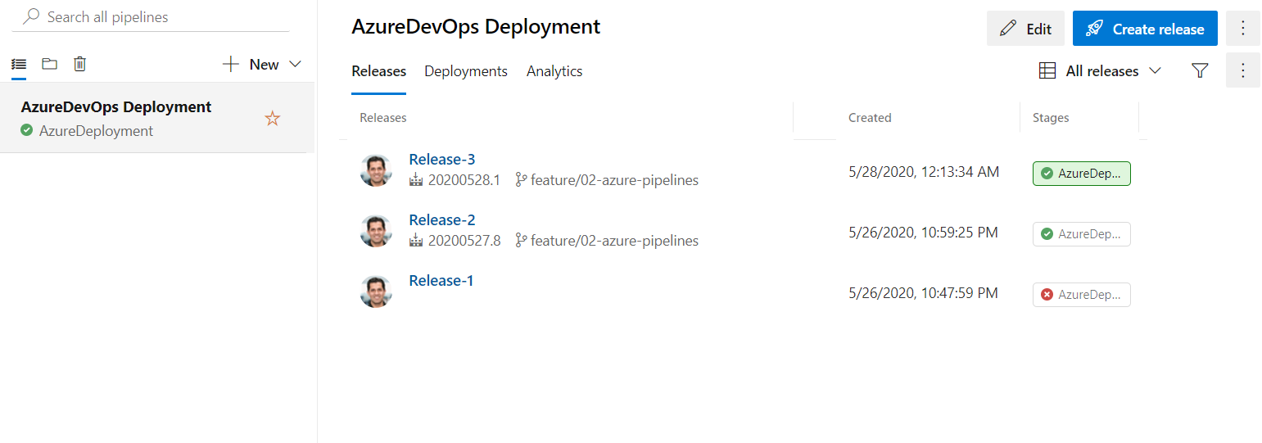

Slide 19
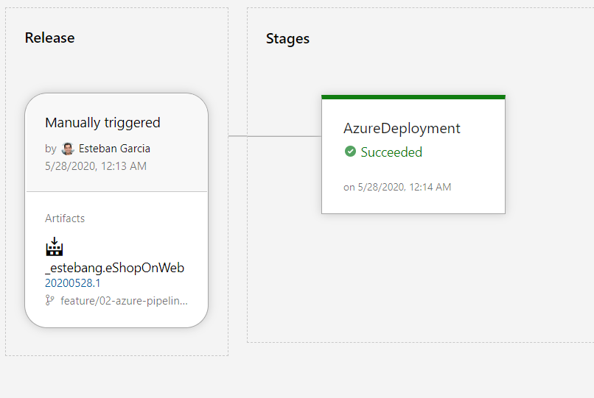

Slide 20
GitHub Actions
Run a workflow on any GitHub event
Linux, macOS, Windows, ARM, and containers
Matrix Builds
Any Language
Live logs
Secret store
Community-powered workflows
@EstebanFGarcia

Slide 21
Demo
@EstebanFGarcia

Slide 22
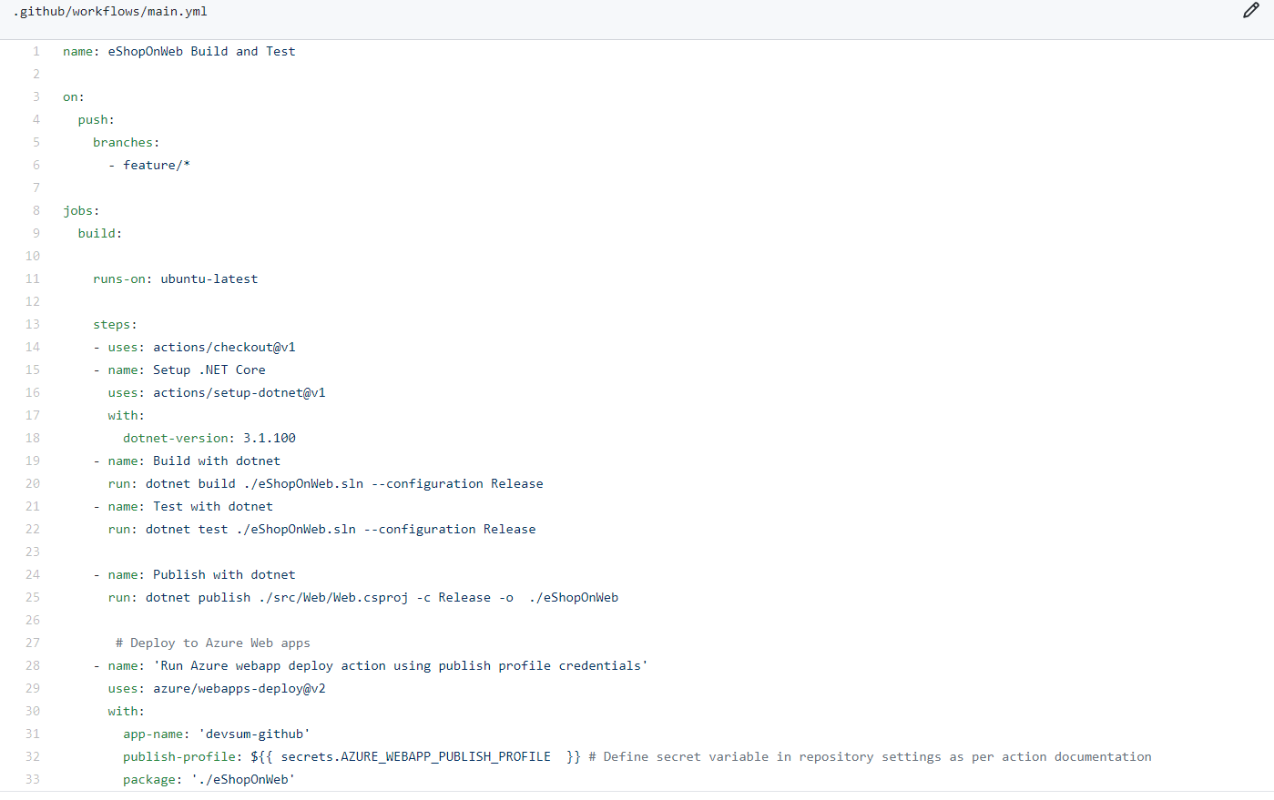

Slide 23
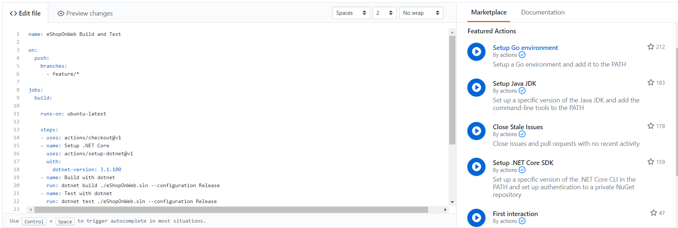

Slide 24
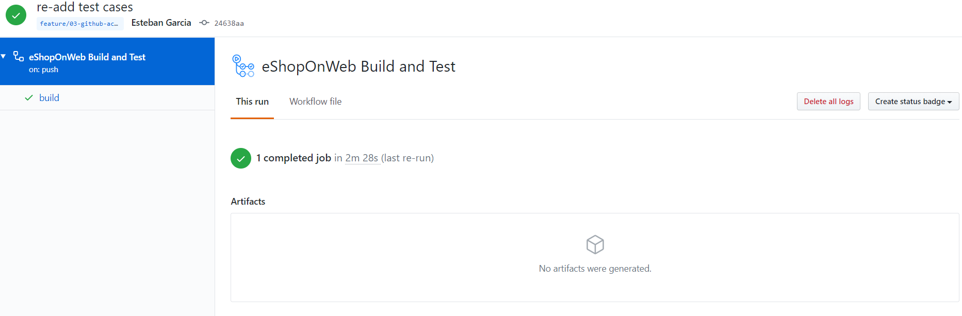

Slide 25
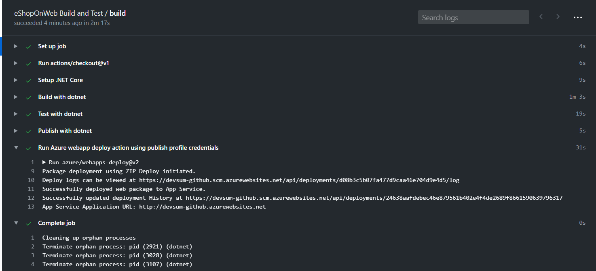

Slide 26
Esteban Garcia - @EstebanFGarcia
@EstebanFGarcia

